Slide 1
The role of pathogen genomics in COVID19 outbreak response
Alan Christoffels
South African Medical Research Council Bioinformatics Unit, South African National Bioinformatics Institute, University of the Western Cape, South Africa, Secretariat: Public Health Alliance for Genomic Epidemiology

Slide 2
The role of pathogen genomics
What is genomics?
Genome
is an organism’s complete set of DNA organised as genetic messages. It includes all the information that is needed to construct an organism and to keep this organism functional.
Genomics
represent a branch of molecular biology that deals with the structure, function, changes in DNA, and mapping of genomes.
Notes:
Firstly, a genome is an organism’s complete set of DNA organised as genetic messages. It includes all the information that is needed to construct an organism and to keep this organism functional.
Genomics on the other hand represent a branch of molecular biology that deals with the structure, function, changes in DNA, and mapping of genomes.

Slide 3
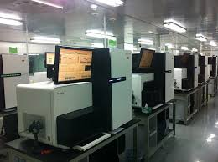
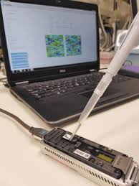
The role of pathogen genomics
How do we identify this genome material?
HiSeq Sequencing Platform
Minion sequencing from Oxford Nanopore
Reduction in size of the sequencing machines
Notes:
How do we identify this genome material?
Technology has advanced rapidly in the genetics applications space such that we have machines that are able to unravel the genetic code within a biological sample. These machines are called DNA sequencing machines referring to the process of obtaining a string of genetic code or “DNA sequence” or “RNA sequence” in the case of SARS-COV-2
These DNA sequencing machines have evolved rapidly to the point where cost has plummeted, and the reduced size of these machines ensure portability. Both these factors have removed the barrier to entry for resource limited laboratories to acquire and utilize it in a clinical setting for molecular diagnostics.

Slide 4
The role of pathogen genomics
How does this sequencing apply to COVID19?
Unique human fingerprint
Mutations (black letters) give each each virus a unique fingerprint
TCAAATGCGTACCAAACCTG
TTCAAATGCGTACCAAACCT
TCTTCAAATGCGTACCAAA
TCTTCAAATGCGTACCAAA
Human genome=3 billion characters
= 20,000 books stacked up
Each book = 1500 letters
Corona virus genome =29,000 characters
= 19 books stacked up.
Each book = 1500 letters
Notes:
How does sequencing apply to COVID19?
Sequencing the SARS-COV-2 genome was key to identifying it as the virus that causes COVID19. SARS-COV-2 has a genome that contains approximately 29,000 letters representing the DNA (RNA) alphabet. A virus sample obtained from a patient can be placed in a DNA sequencing machine to obtain the full length of the 29,000 characters that represent the virus genome or the virus finger print.
The 29,000 characters are produced as a printout of strings of 100-200 characters. Millions of character strings are generated. Think of this as a massive jigsaw puzzle.
At this stage we have to depend on computers to assist us in piecing together this puzzle.
Through a process of quality control and matching the different strings to find overlapping ends, we can generate the complete assembly of all the strings to form one genetic fingerprint or genome sequence for the virus. This complete genome information allows for the development of molecular diagnostics to rapidly identify COVID19 infections.

Slide 5
The role of pathogen genomics
Sequencing Capacity in Africa
Northern Africa
Western Africa
Central Africa
Eastern Africa
Southern Africa
Sequencing capacity
Notes:
Sequencing Capacity in Africa
The black dots on this map depict the laboratories that can accommodate national scale-up of DNA sequencing capability. Initiatives through joint efforts of the Africa CDC and African Society for Laboratory Medicine (ASLM) aims to extend this sequencing capacity across the African continent. Sequencing of viruses have been used during other outbreaks in Africa such as the Ebola outbreak in 2014.
Scaling up Pan-African sequencing capacity is not without challenges including access to, and affordability of, chemical reagents to operate these DNA sequencing machines.

Slide 6
The role of pathogen genomics
How is the genomic data shared with others?
There are international databases that store and provide access to a range of genomic data. Some of these databases are specific for one disease or for an organism.
The Global Initiative on Sharing All Influenza Data (GISAID) is a public-private partnership that promotes international sharing of ALL influenza virus sequences, and associated meta data such as a clinical data in the case of human viruses or species-specific data for birds and animal viruses.
Scientists are allowed to submit SARS-COV-2 genome data to GISAID
https://www.gisaid.org/
Raw DNA sequencing data for SARS-COV-2 can be submitted to the Sequence Read Archive:
https://submit.ncbi.nlm.nih.gov/subs/sra/
Notes:
Data management is a key element of genomic sequencing and requires that data are accurately collected, labelled or annotated, and curated. These processes make it easier for others to find and reuse the data. Data sharing requires that data adhere to the FAIR principles.
Data should be: F – Findable; A – Accessible ; I – interoperable ; R – Reusable
Developing Standards require agreement on how to share genomic data between collaborators so that data is not corrupted or missing from a file.
The Global Initiative on Sharing All Influenza Data (GISAID) is a public-private partnership that promotes international sharing of ALL influenza virus sequences, and associated clinical data in the case of human viruses
Scientists are allowed to submit SARS-COV-2 genome data to GISAID
https://www.gisaid.org/
Raw DNA sequencing data for SARS-COV-2 can be submitted to the Sequence Read Archive:
https://submit.ncbi.nlm.nih.gov/subs/sra/

Slide 7
The role of pathogen genomics
How do I use this data to control COVID19 spread?
Compare all the virus genomes and find differences (SNPs)
(MAFFT)
Globally collected virus genomes
(GISAID)
Locally sequenced virus genomes
Inform public health response
new virus emerging?
Spread of virus to other regions?
Track the transmission history of the local virus
Use the SNPs to group virus fingerprints together
(Nextstrain)
Genomic Epidemiology
Notes:
How do I use this data to control COVID19 spread?
On the previous slide we learnt about GISAID – the database to store corona virus sequences.
Step1 – download a collection of SARS-COV02 virus sequences. And combine those with your own locally sequenced virus genomes.
Step 2- Software programs such as MMFAT allows you to compare 1000s of viral sequences. This comparison is called an alignment. The differences obtained at specific locations provide the unique fingerprint for each virus sample.
Step 3 – group the sequences using computer programs like Nextstrain. These groups will give us an idea of the distribution of these viruses. Remember, each virus fingerprint also has other information associated with it such as country, patient data, date of collection etc. with this information we can now follow the spread of COVID19. Lets take a practical example.

Slide 8
The role of pathogen genomics
An example of using COVID19 data for genomic epidemiology?
Position 241
Alignment of 3069 virus sequences
Belgium and SA sequences have a ”T” at position 241
Hongkong Sequences have a “C” at pos.241
Notes:
How do I use this data to control COVID19 spread?
The image on the left show a snapshot of a larger collection of 3609 COVID19 virus sequences. A red arrow points to position 241 in a 29,000 long sequence. Look at the vertical line below position 241. Some sequences (Belgium and SA) have a “T” at that position. Other sequences (Hongkong) have a “C” at that same position.

Slide 9
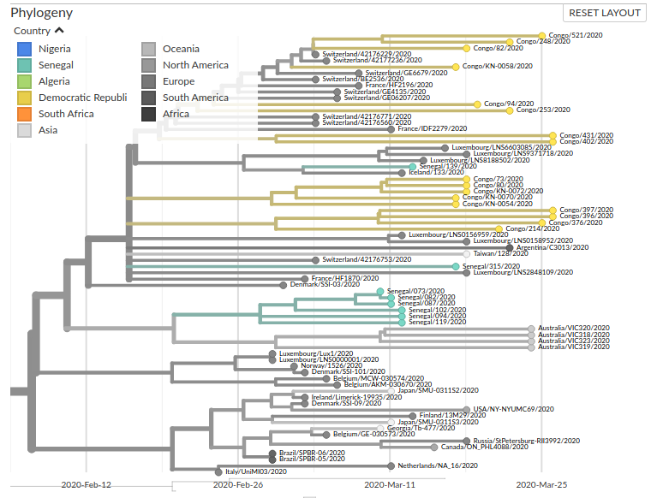
The role of pathogen genomics
An example of using COVID19 data for genomic epidemiology?
Multiple clusters from Senegal –
Suggests that the virus was introduced multiple times
(pink arrows)
3
2
1
Notes:
How do I use this data to control COVID19 spread?
The image on the left is a zoomed in section of a much larger picture of 3609 virus sequences. This analysis was done with the software, NextStrain. The horizontal lines in this tree are called branches. Each branch depicts a virus genome. Branches that are longer imply more mutations in that virus genome. The position where the branches intersect is called a node. Two branches that share a node means that those two virus genomes are more similar or have less mutations when compared to a virus genome (branch) elsewhere in this tree. Look at the first pink arrow; Senegal branches share nodes not shared by other viruses. And this means that these viruses obtained in Senegal are more similar to each other than viruses obtained from other countries. This group or cluster of Senegal virus genomes are changing within the country. The Senegal cluster also shares a node with a cluster of viruses obtained from Australia. Pink arrows 2 and 3 shows additional virus genomes sequenced in Senegal and implies that the virus was introduced multiple times into Senegal. The dates on the horizontal axis such as 26th February 2020 and 11th march 2020 gives you an idea of how fast the virus is mutating between nodes. More sequencing data is needed to give an improved picture of how the virus is spreading within a country and between countries.

Slide 10
The role of pathogen genomics
Who oversees the development of these data standards?
Public Health Alliance for Genomic Epidemiology (PHA4GE)
Data
Sharing
Data
Infra-
structure
Analysis
Methods
Sequence
Databases
Training &
Workforce
Dev
Quality
Control,
validation
Data sharing,
And
Ethics
Training
Users
@pha4ge
Users &
Applications
Users &
Applications
Users &
Applications
https://pha4ge.org/
Notes:
Who oversees the development of these data standards?
There are variety of global initiatives aimed at championing the development of open-source data standards.
In October 2019, the Bill & Melinda Gates Foundation funded the launch of a global initiative called the Public health Alliance for Genomic Epidemiology (PHA4GE). PHA4GE was established to champion the support for development of bioinformatics and data standards for public health. There are 8 working groups in this global initiative. This global community provide a forum to debate new data exchange standards, or to drive the establishment of best practices for using computing protocols in public health to analyse viruses such as SARS-COV-2 or bacterial drug resistance. identification.
http://www.pha4ge.org

Slide 11
The role of pathogen genomics
How do I acquire skills in genomics in Africa?
Bioinformatics training across Africa:
H3Africa Bioinformatics Network with a focus on human genomics
http://h3abionet.org
The African Society for Bioinformatics and Computational Biology
Human, animal and agriculture
http://www.asbcb.org
Africa CDC’s Pathogen Genomics Intelligence Initiative
Facilitate training of bioinformaticians and systems engineers via the South African National Bioinformatics Institute
http://www.sanbi.ac.za
Notes:
How do I acquire training in data analytics in Africa?
There are a number of initiatives across Africa devoted to bioinformatics including National Institutes of Health and Wellcome Trust funded H3Africa Bioinformatics Network with a focus on human genomics. The African Society for Bioinformatics and Computational Biology provides a community of practice that is driving data intensive research across a wide range of disciplines including human, animal and agriculture.
More recently the Africa CDC launch a Pathogen Genomics Intelligence Initiative with the purpose driving data analytics training support and applications across the African Continent.
Through partnerships with organisations such as the South African National Bioinformatics Institute, they aim to build a data analytics platform that can be deployed at National Public Health Institutes. Through this partnership they envision a data analysis skills force that includes both bioinformatics scientists and system engineers.
http://www.asbcb.org ; http://h3abionet.org ; http://www.sanbi.ac.za

